Slide 1
Volunteer Program Update
Open Space and Regional Parks Commission
September 3, 2019

Slide 2
Program Overview
Parks volunteer program is in its 10th year
Grown to almost 17,000 volunteer hours in 2018, equivalent to 8 additional full time employees.
Volunteers provide an estimated national value of over $430,000.
Notes:
Independent Sector is the only national membership organization that brings together the charitable community—a diverse set of nonprofits, foundations, and corporations—to advance the common good.
Why Do We Calculate a Value of Volunteer Time?
We know putting numbers to volunteer hours will never do them justice, but it is just one way for us to show the contributions individuals and organizations have made in our communities. The estimate helps acknowledge the millions of individuals who dedicate their time, talents, and energy to making a difference. Charitable organizations frequently use this estimate to quantify the enormous value volunteers provide.

Slide 3
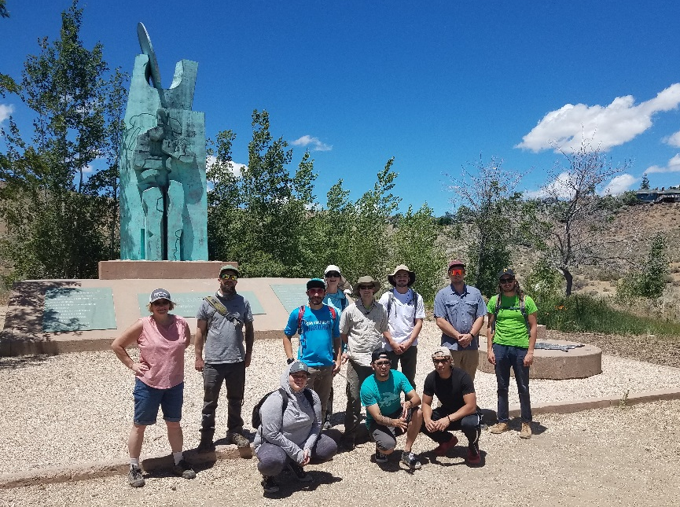
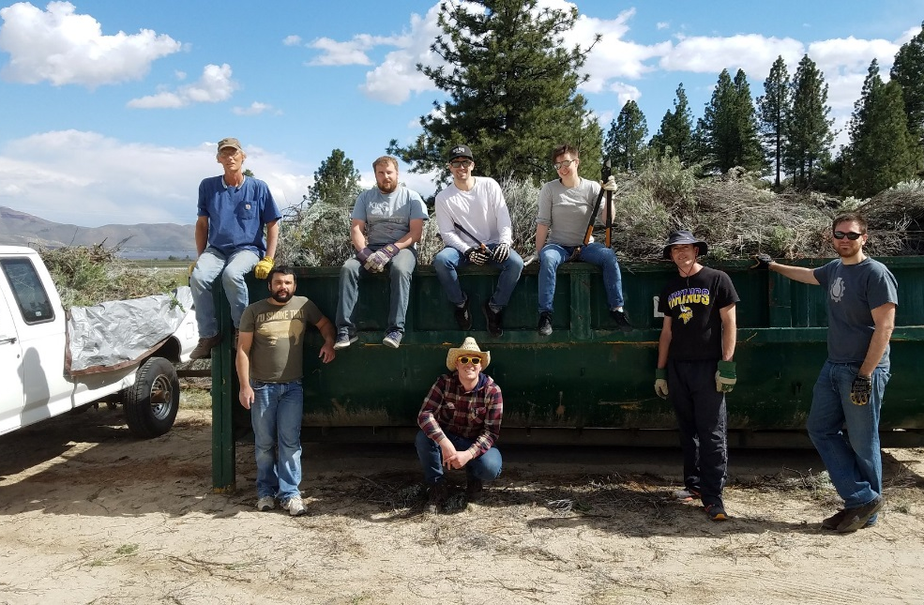
Community Volunteers
Bulk of volunteer hours come from half day events with community groups – including corporate volunteers, religious organizations & school groups.
Patagonia employees at Basque Monument
I.G.T employees at Davis Creek Regional Park

Slide 4
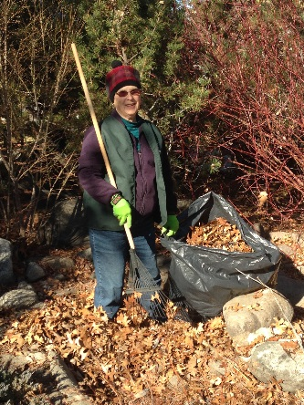
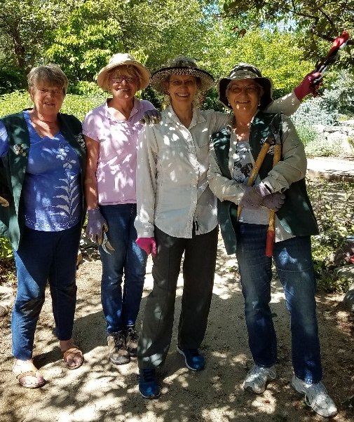
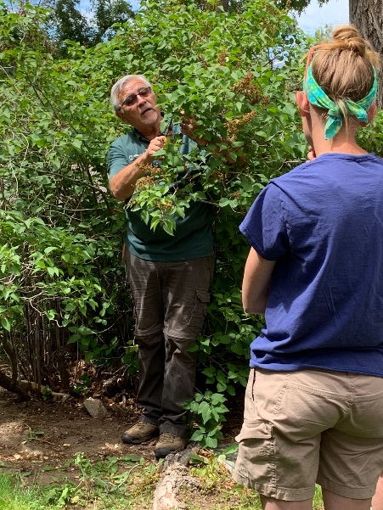
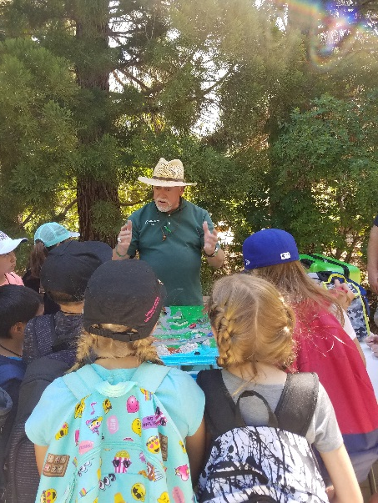
Arboretum Volunteer Program
75 volunteers in database
4,000 annual vol. hrs.
Gardening, Education, MAS
Tues & Thurs AM - gardening
Mentor program
Monthly gardening series
Volunteer newsletter
Appreciation events

Slide 5
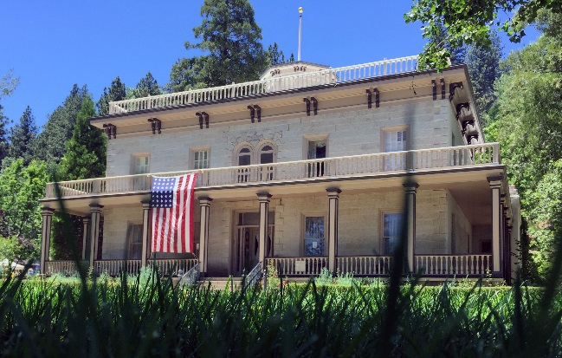
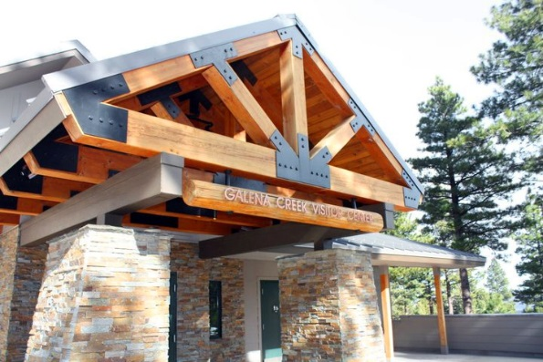
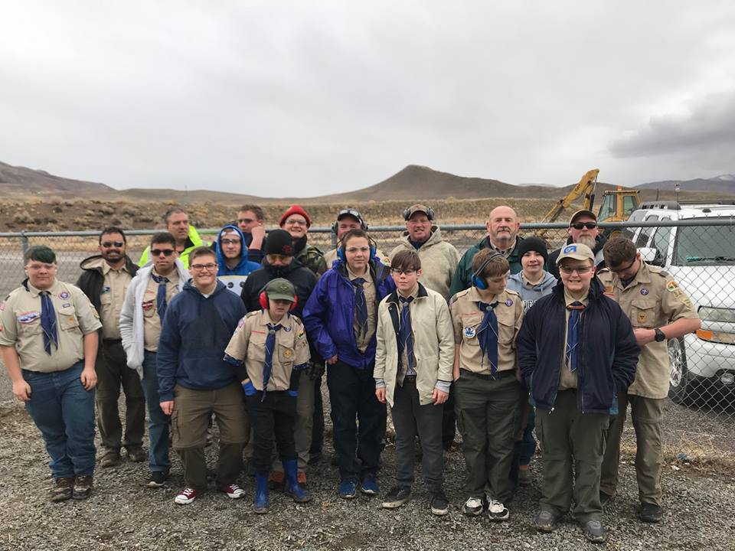
Other Volunteers
Park Ranger Aides
Bowers Mansion Docents
Discovery Room at Rancho San Rafael
Galena Creek Visitor Center
Hosts & Program Assistants
Regional Shooting Facility
Assisting the Range Master
Eagle Scouts
Collaborate with staff on needed projects, often totaling up hundreds of volunteer hours by completion.

Slide 6
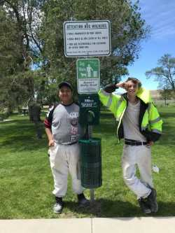
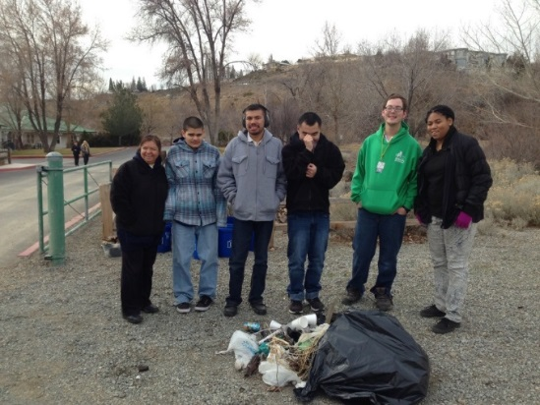
Partners
Sierra Nevada Job Corp
Work Based Learning program
Placed in positions that compliment their vocation
Approximately 32 hours a week for 6-8 weeks
Projects with Concrete/Masonry, Welding
Nevada Youth Empowerment Project
Transitional housing for young women who are aging out of foster care.
Volunteering teaches job skills and is a healthy extracurricular activity.
Washoe County School District’s Transition Services
Vocational training for students with disabilities.

Slide 7
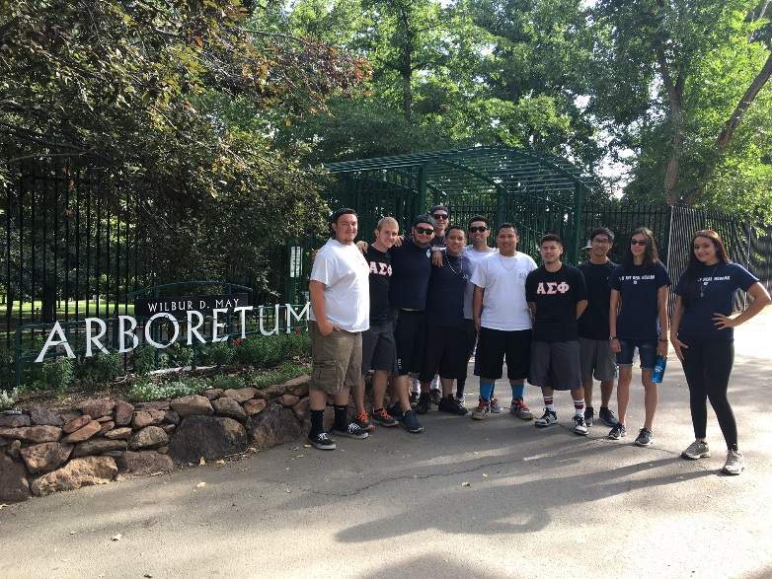
Partners
University of Nevada, Reno
Center for Student Engagement/#iLead Nevada initiative
School clubs/groups
Fraternities/Sororities
Monday night volunteers
Pack Internship Grant Program
Playground Safety Specialist Intern
Unpaid Internships
Honors Studies
Community Engagement
Museum Studies & Arboretum Interns

Slide 8
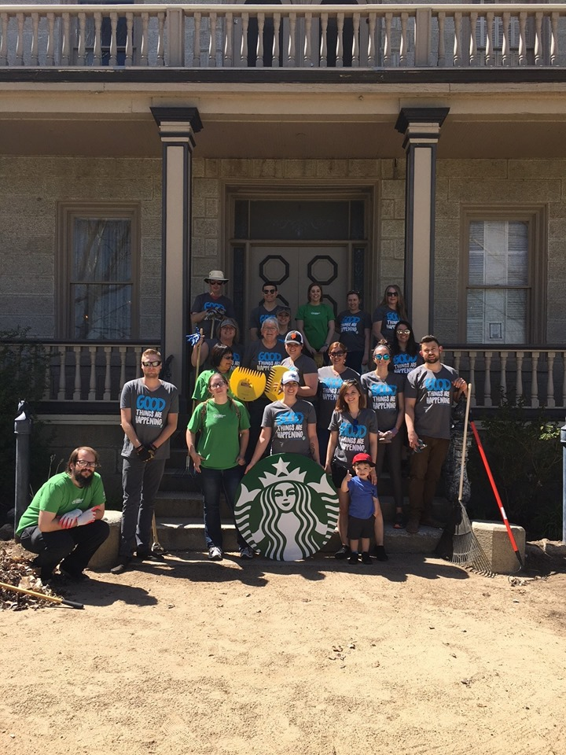
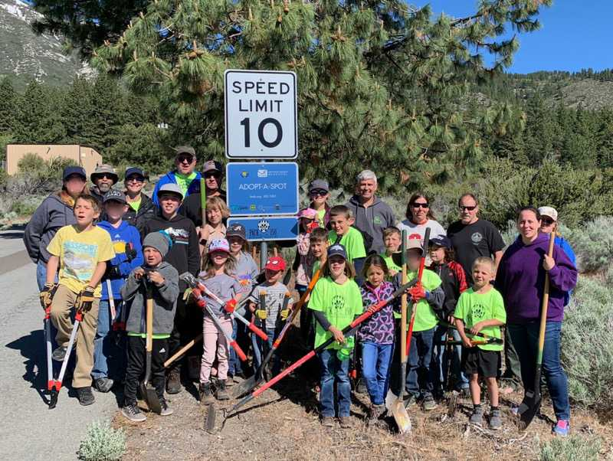
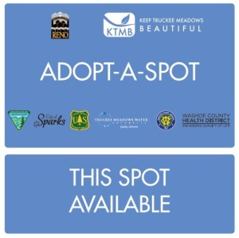
Partners
Keep Truckee Meadows Beautiful
Great Community Cleanup
Truckee River Cleanup
Adopt-A-Spot program

Slide 9
Last but not least… Thank you for being a part of our program by volunteering your time as Park Commissioners!

